Slide 1
Eurostat and renewable energy statistics Ukraine visit to the EEA 23 October 2025
Fernando Díaz Alonso
European Commission - Eurostat

Slide 2

Energy Union, REPowerEU, Clean Industrial Deal
The first climate neutral continent by 2050
Affordable, secure and sustainable energy for Europe
save energy, produce clean energy and diversify energy supply
High-quality data essential to monitor energy policies

Slide 3

Eurostat is the statistical office of the European Union (EU)
Our mission is to provide high-quality statistics and data on Europe
Eurostat produces European statistics in partnership with National Statistical Institutes and other national authorities in the EU Member States. This partnership is known as the European Statistical System (ESS)

Slide 4

Legal basis for energy statistics
Regulation (EC) 1099/2008 on energy statistics
Energy prices based on Regulation (EU) 2016/1952
Notes:
Photo by Tingey Injury Law Firm on Unsplash

Slide 5
Other European legal texts with influence on energy data
Regulation (EU) 2018/1999 of the European Parliament and of the Council of 11 December 2018 on the Governance of the Energy Union and Climate Action
Directive (EU) 2023/2413 on the promotion of the use of energy from renewable sources (RED III)
Directive (EU) 2023/1791 on energy efficiency
Council Regulation (EU) 2023/706 amending Regulation (EU) 2022/1369 on gas demand-reduction
Council Directive 2009/119/EC imposing an obligation on member states to maintain minimum stocks of crude oil and/or petroleum products

Slide 6
Annual data
The annual Energy Balances of the Member States and EnC contracting parties and the EU are the key output of this data collection.
Together with the SHARES tool, energy balances (used for Annex XVI, Table 9) provide valuable information on the structure of the energy systems across the EU; allow monitoring of major EU and national energy policies and targets (energy dependency, penetration of renewable energy sources, energy efficiency) while it contributes significantly to assess the carbon dioxide annual emission inventories.

Slide 7
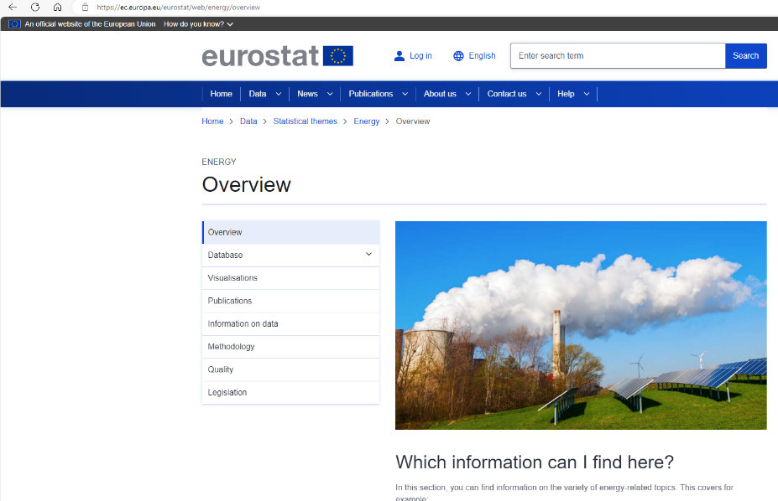
Eurostat’s energy website

Slide 8
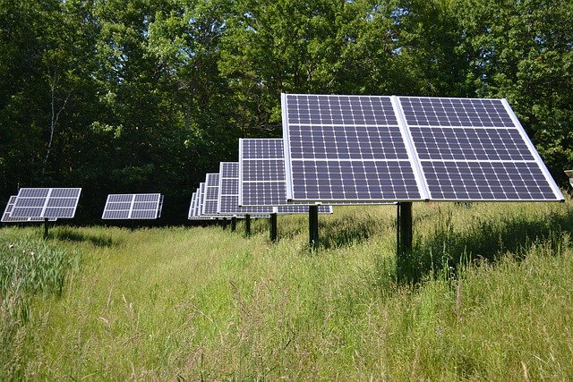
Renewable energy statistics
Notes:
Image by WikimediaImages from Pixabay

Slide 9
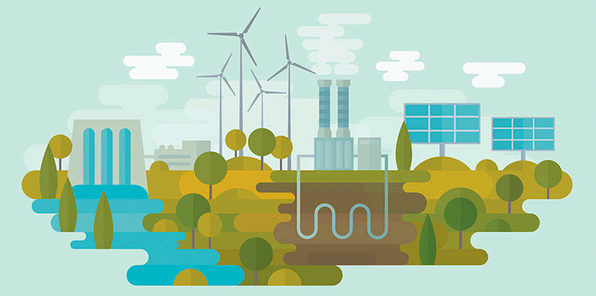
Renewable energy sources
Hydro
Geothermal
Solar photovoltaic
Solar thermal
Ambient heat (heat pumps)
Tide, wave and ocean
Wind
Industrial waste
Municipal waste
Solid biofuels
Biogases
Biodiesels
Biogasolines
Other liquid biofuels

Slide 10
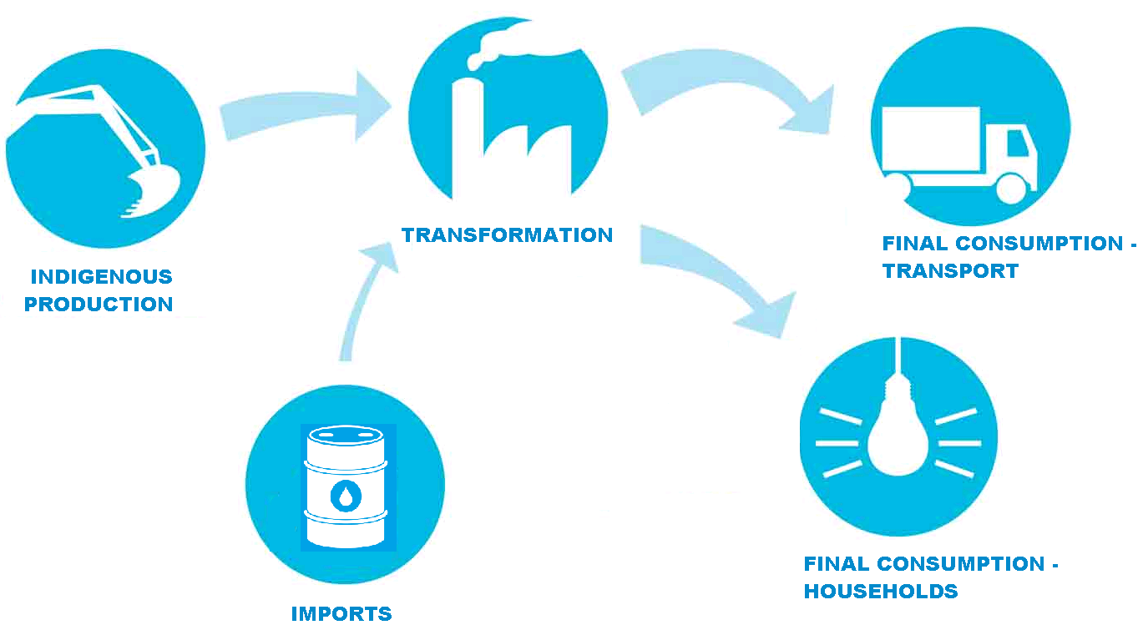
General structure: flows
Indigenous production
Imports
Exports
Stock changes
Inland consumption
Statistical differences
Transformation sector
Energy sector
Distribution losses
Final energy consumption
Industry sector
Transport sector
Other sectors
Commercial and public services
Residential
(…)

Slide 11

Infrastructure and capacity
Net maximum electrical capacity (MW on 31 December) for Hydro, Geothermal, Solar photovoltaic, Solar thermal, Tide, wave and ocean, Wind, Industrial waste, Municipal waste, Solid biofuels, Biogases, Biodiesels, Biogasolines, Other liquid biofuels
Solar collectors surface (1000 m2) for production of solar thermal heat (glazed and unglazed collectors, flat-plate and vacuum tube with a liquid or air as the energy carrier).

Slide 12
General structure: infrastructure and capacity tables
Liquid biofuels average net calorific value (kJ/kg)
Charcoal average net calorific value (kJ/kg)
Liquid biofuels densities (kg/l)

Slide 13
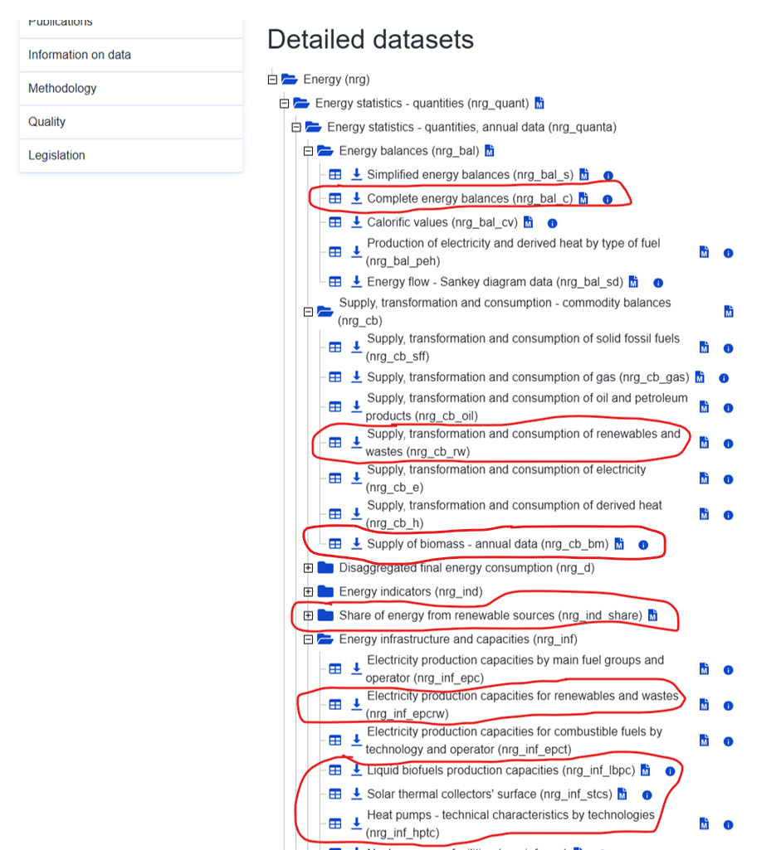
Database
Notes:
A, capacity is allocated to the fuel with more weight in the mixture

Slide 14
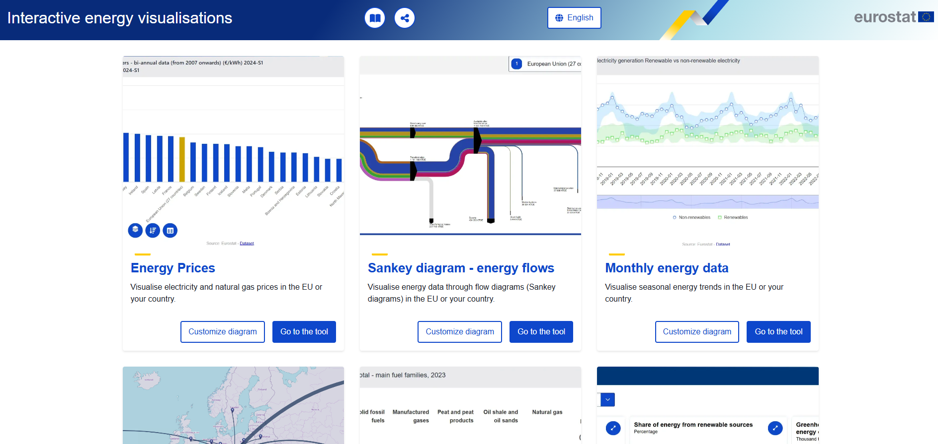
Visualisation tools
Notes:
A, capacity is allocated to the fuel with more weight in the mixture

Slide 15
SHARES (Short Assessment of Renewable Energy Sources) Annex II, tables 1 to 5

Slide 16
Introduction
Calculation of the share of renewables according to RED
SHARES tool does not replace legal obligations in RED II — it only assists in reporting.
Member States go through the exact same method during the calculation of the share.
Prevents any irregularities from varying parameters and rules used in different calculation methods and ensures harmonised and comparable results for all reporting countries.
Using SHARES tool is a more efficient approach than individual estimations/calculations performed by each EU Member State.

Slide 17
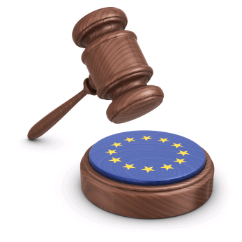
Legal basis
Up to reference year 2024, SHARES is based on Directive 2009/28/EC and 2018/2001 (RED I and RED II) on the promotion of the use of energy from renewable sources.
This presentation refers to the SHARES tool currently used for reporting, i.e. before RED III.
From reference year 2025 onwards, SHARES will be adapted to RED III (Directive 2023/2413).
But there is also input from annual questionnaires

Slide 18
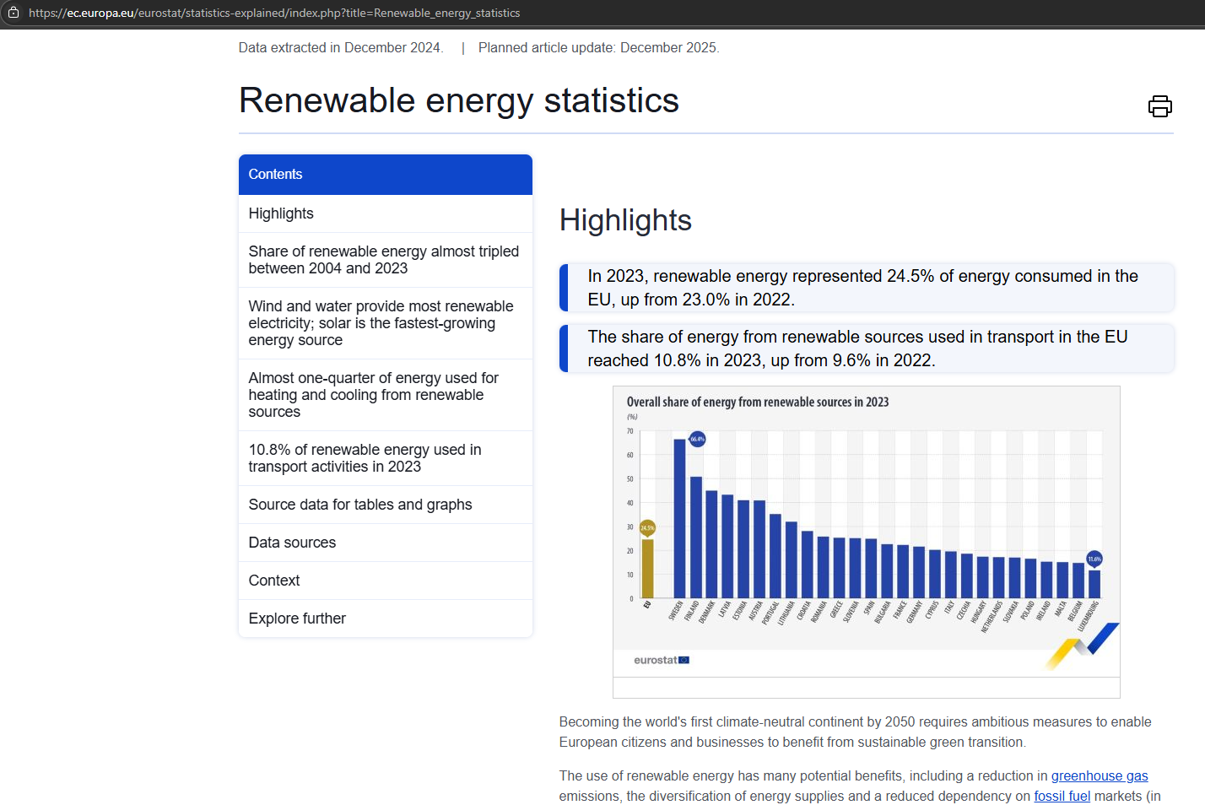
More information in Statistics Explained – Renewable energy statistics:

Slide 19

Components
SHARES offers results on four components:
RES (%) – overall share of energy from renewable sources
RES-E (%) – share of energy from renewable sources in electricity
RES-T (%) – share of energy from renewable sources in transport
RES-H&C (%) – share of energy from renewable sources in heating and cooling

Slide 20

Input – annual questionnaires
Based on annual energy statistics under Regulation (EC) No 1099/2008. Five annual energy questionnaires are uploaded into SHARES :
Coal (covers solid fossil fuels and manufactured gases)
Oil (covers crude oil and derived oil products)
Natural gas
Electricity & Heat
Renewables (also includes renewable and non-renewable wastes)
From reference year 2025 onwards also hydrogen

Slide 21

Input – additional data
Countries to provide additional information that is not covered by Regulation (EC) No 1099/2008:
Compliant (sustainable) biofuels, biomass, biomass fuels and bioliquids
Heat pumps (to be removed from 2025 onwards)
Mixed hydro plants (to be removed from 2025 onwards)
Cooperation mechanisms (statistical transfers)
Biomethane injected in the grid, imported or exported and/or to be accounted towards a specific sector (e.g. transport) on the basis of the mass-balance system
Renewable cooling

Slide 22

Introduction – SHARES Manual
Additional data - Energy - Eurostat (europa.eu)

Slide 23
Some reflections
The SHARES based on RED:
Specific definition of gross final energy consumption that excludes sectors involved in energy transformation (including transformation losses) but includes losses due to transmission and distribution. As such, this is a new aggregate which does not exist in Eurostat's energy balances.
Electricity produced from hydro and wind is normalised for annual variations.
Use of multipliers for e.g. electricity in road vehicles, advacend biofuels, etc.).
Only sustainable biofuels and bioliquids are taken into account.

Slide 24
Some reflections
The SHARES based on RED:
Energy consumption of aviation is capped if the aviation sector is significant in the energy consumption of the country.
Bioliquids and biofuels from food sources are also capped.
Statistical transfers of renewable energies between countries and joint projects with countries outside the EU provide for administrative transfer of quantities of renewable energies between countries. This element is not reflected in Eurostat's energy balances.

Slide 25
Biomass Annex II, table 6

Slide 26
Biomass reporting
Collect the solid biomass additional reporting obligations stemming from Annex IX Part 1 (m) of Regulation (EU) 2018/1999 on the Governance of the Energy Union and Climate Action
Only solid biomass flows used for meaningful energy purposes (electricity and heat production) should be reported in this questionnaire.
Liquid and gaseous biofuels should not be included

Slide 27
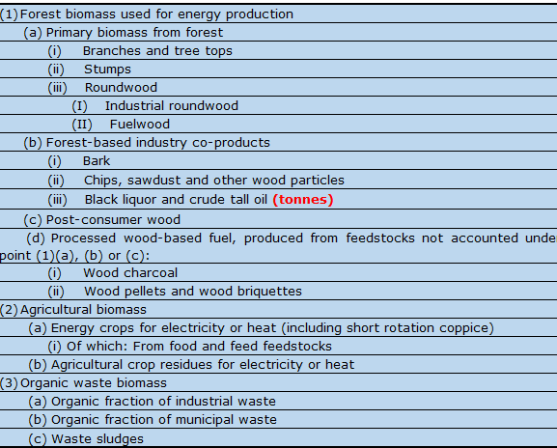
Biomass reporting

Slide 28
NECPR reporting – some thoughts

Slide 29
NECPR reporting
Based as much as possible on Eurostat’s data
When available, using the same structures, definitions and methodology
Table structures copied as much as possible to facilitate understanding, limit data errors and additional effort from reporting countries
The collaboration between the EEA and Eurostat intends to achieve the above-indicated points

Slide 30

Questions and conclusions

Slide 31
Thank you for your attention! Fernando.Diaz-Alonso@ec.europa.eu http://ec.europa.eu/eurostat

